Slide 1
Cyber Safety for the Digital Generation
Help safeguard your identity, privacy, and security with all-in-one protection through
Norton LifeLock Benefit Plans.
2025

Slide 2
Another Impactful Year of Data Breaches
Total Compromises in 2024
Top compromises by industry
Total attack vectors:
737
Financial Services
317
Manufacturing
Cyberattacks
System and human errors
3,158
Total compromises
44 Events Short of 23 All-Time-High
2,525 breaches |
1.2B victims
310 breaches /
exposures | 116M victims
536
Healthcare
173
Education
Physical
attacks
Supply
chain attacks
345
Professional Services
33 breaches / exposures | 189,000+ victims
134 breaches / exposures | 203M victims
1,350,835,988
Victim Notices
211% increase YOY
Top 5 compromises
by victim count:
Ticketmaster
Entertainment, LLC
Change
Healthcare
DemandScience
by Pure Incubation
AT&T
MC2 Data
Notes:
“2024 Data Breach Report,” Identity Theft Resource Center, January 2025.

Slide 3
Keep my personal information and finances safer
Identity and Financial Protection

Slide 4
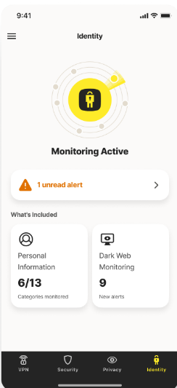
Identity and
Financial Protection
Keep My Personal Information and Finances Safer
  Identity & Social Security Alerts
  We monitor our network and alert you if we detect a bank, utility or other company (i.e. phone carrier) attempting to verify your identity so you can take action to help protect your identity, if this was not initiated by you.
  Million Dollar Protection Package
  If you became a victim of identity theft, you will be covered for personal expenses you incur and money stolen as a result of identity theft, and we will provide lawyers and experts, up to $1 million, if needed to help resolve your case,
  Bank Account Takeover Alerts
  Smart identity thieves use their computers to take over accounts or add new account holders to existing accounts. LifeLock helps protect your finances by monitoring for these changes and alerting you.
  Checking & Savings Account Application Alerts
  Continuously searches for your personal information in new bank account applications at national banks, local banks, and credit unions.
  Dark Web Monitoring
  LifeLock patrols the Dark Web and notifies you if we find your information, such as your username, password, IP address, or gamer tag.

Slide 5
Million Dollar Protection Package
Our extensive safety net for employees if needed
Up to
$1 Million
for Lawyers
and Experts
If needed, we’ll retain lawyers and experts directly on behalf of our member to help solve their identity theft
Up to $3 million in coverage for each eligible member, in the rare event it’s needed
Up to
$1 Million
for Expense Reimbursement
No limits on the number of claims a member can file in a year
We reimburse expenses resulting from identity theft like childcare, travel, document replacement, and lost wages
No limits on the number of occurrences for reimbursement
Up to
$1 Million
for Stolen Funds Reimbursement
No sub-limits to worry about
We’ll reimburse money directly back to the member if they have stolen funds from their bank, investment, or credit accounts due to identity theft
Financial accounts not linked for monitoring may still be covered
for reimbursement

Slide 6
Threat Landscape
Identity
Digital
Privacy
Financial
There’s a victim of identity theft every
5 seconds.
1 in 4 were targeted by scams in 2024.
Nearly 50% of consumers have experienced a data breach.
70% of scam victims were impacted financially.
Identity theft victims spent an average of 17 hours trying to resolve the fraud.
Scam victims spent an average of 21 hours resolving issues caused
by the scam.
If your info is exposed or stolen in a data breach, it can end up on the dark web where it can be sold for as little as 10 cents.
78% of employees say money is a source of stress.
6
Notes:
CL584: There’s a victim of identity theft every 5 seconds.
CL644: Identity theft victims spend an average of 17 hours trying to resolve the fraud.
CL633: 1 in 4 were targeted by scams in 2024. (citation: Based on an online survey of 12,024 adults in 12 countries conducted by Dynata on behalf of Gen in December 2024.)
CL638: Scam victims spent an average of 21 hours resolving issues caused by the scam.
H183: Nearly 50% of consumers have experienced a data breach.
B10: If your information is exposed or stolen in a data breach, it can end up on the dark web where it can be sold for as little as 10 cents.
CL591: 70% of scam victims were impacted financially.

Slide 7

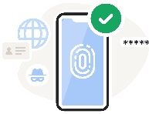

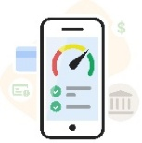
Keep my personal information and finances safer
Identity and
Financial Protection
A New Era of Digital and Financial Protections
Help protect my online life from scams and security threats
Digital Protection
Give me control of
my personal data
Privacy Online
Help me understand
my finances
Financial Wellness
7

Slide 8
LifeLock with Norton Benefit Premier
$XX.XX Employee
$XX.XX Family
Identity and
Financial Protection
Digital
Protection
Privacy
Online
Financial
Wellness
Keep my personal information and
finances safer
Help protect my online
life from scams and security threats
Give me control
of my personal data
Help me manage
my finances
Monitoring & Alerts
Anti-Virus
VPN
Credit Score
Insights NEW
Dark Web Monitoring
Cloud Backup
Social Media Monitoring
Credit Monitoring
Identity Restoration
& Support
Parental Control
Privacy Monitor Assistant NEW
Financial Monitoring
Identity Lock &
Freeze Center
Genie Scam
Protection Pro
COMING SUMMER 2025*
Income & Expense Tracking
COMING FALL 2025*
Password Manager
Million Dollar
Protection Package
*Timeline subject to change.
Notes:
Premier

Slide 9
Give me control of my personal data
Privacy Online

Slide 10

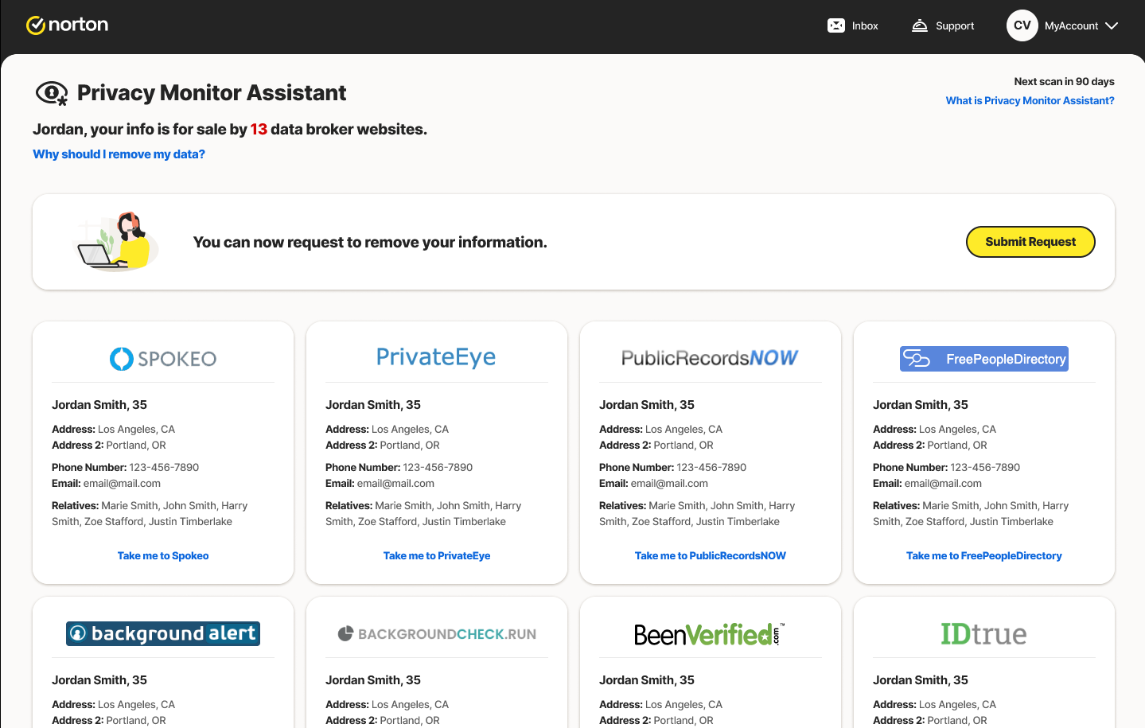
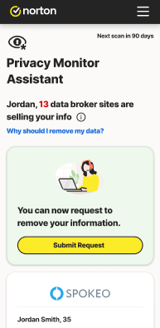
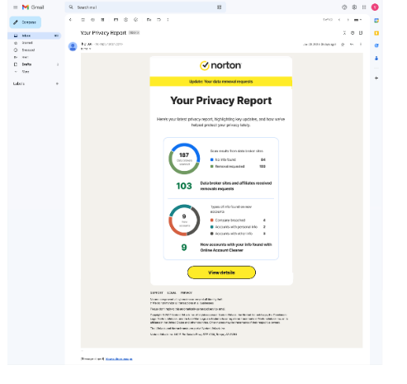
Privacy Monitor Assistant
Give Me Control of My Personal Data
Available in Premier and Premier Plus
Privacy Monitor Assistant helps employees regain control over their personal data:
Your information is exposed
We scan 200+ popular broker sites for your info. (300+ brokers on target for Summer 2025)
You’re opted out
After the initiating removal, our team will handle it
from there.
You get ongoing support & reporting
Re-scanning every 90-days lets you know if your
data was reposted. We immediately begin removal and report progress back to you.

Slide 11
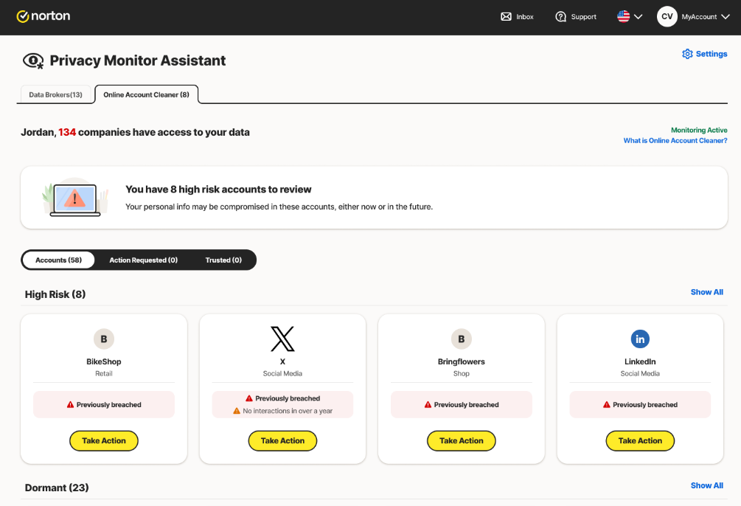
Online Account Cleaner
Give Me Control of My Personal Data
Available in Premier and Premier Plus
Analyze your inbox and manage which companies have your data
Highlights over 1,300 companies that have your data
Uncover old online accounts that hold your personal data and choose if you want to keep or delete them to help reduce your digital footprint and spam
Request your data to be removed
Manage your marketing subscriptions
Or keep as trusted
1,300 Vendors → 2,300 Vendors (April 2025)

Slide 12
Help protect my online life from scams and security threats
Introducing: Genie Scam Protection Pro

Slide 13

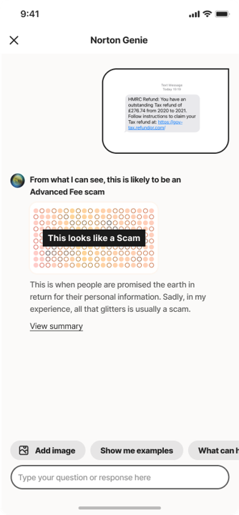
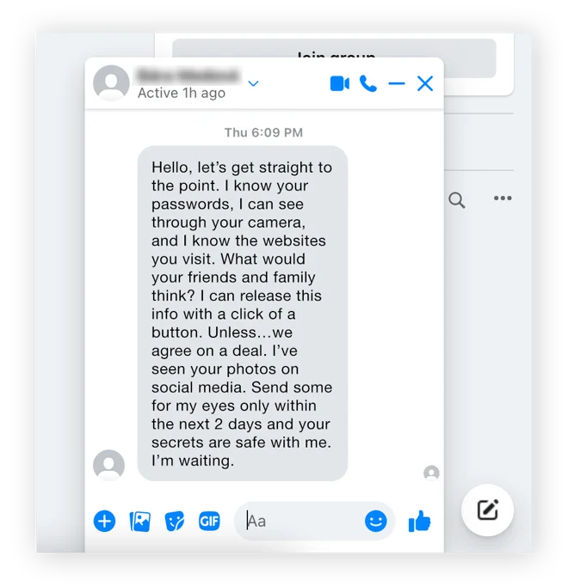
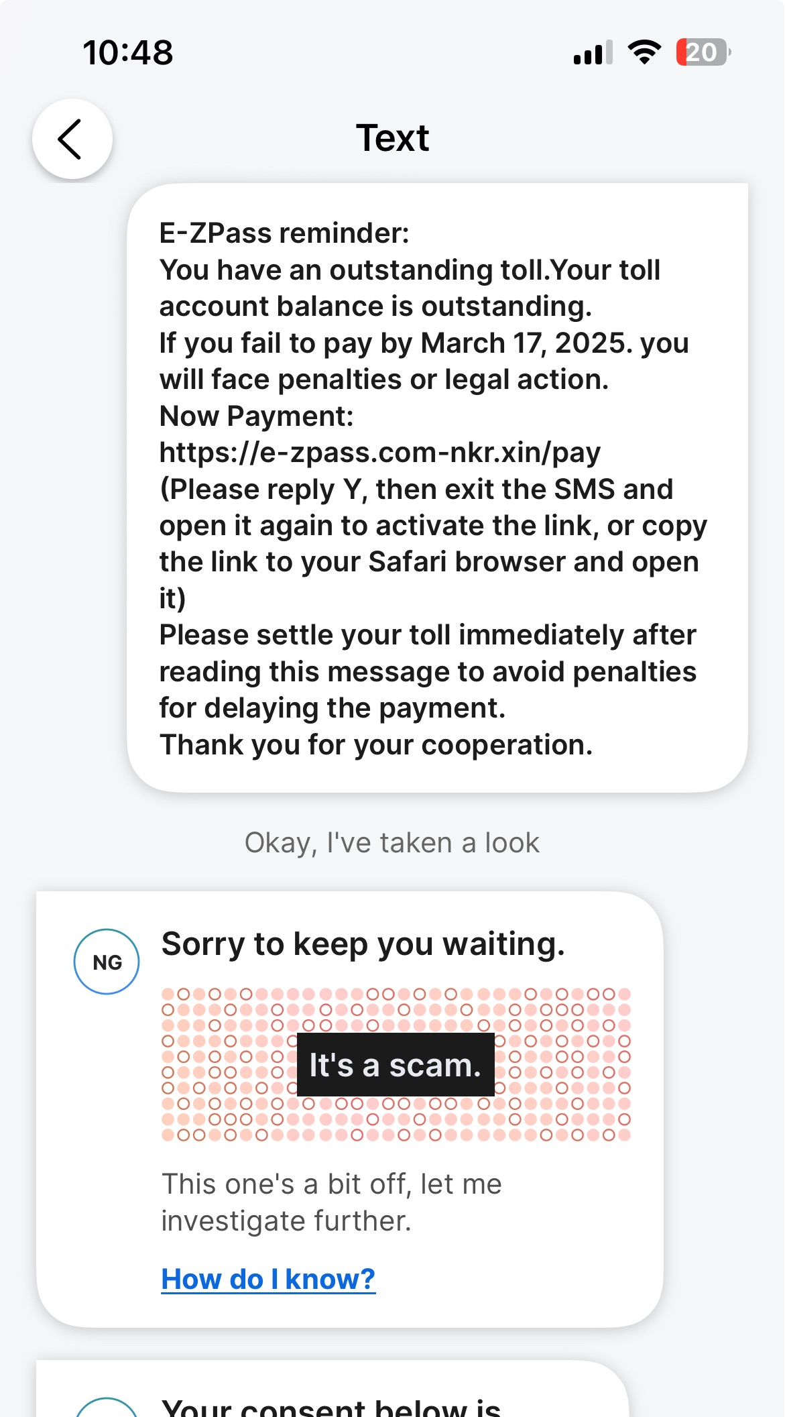
The Scam Landscape
Nearly 90% of blocked attacks are social engineering
Market / FTC data report
double-digit growth in scams YoY
Traditional threats are not necessarily declining
Scams, phishing, and malvertising are growing at a rapid pace
taking up more share of threats blocked
3.4B
Scam related losses reported in 2023
25
Nearly
Number of scams the average American receives a week
52%
of Americans are concerned they will fall victim to a scam
1.6B
scam texts are received every day
1 in 5
people have been victimized by scams in the past year
$10B
Scam related losses reported
in 2023

Slide 14


How does Genie spot scams others miss?
Genie’s AI tech will be available in Norton LifeLock Benefit Plans Summer 2025*
Genie AI is a game-changer for security.
Norton’s Genie AI engine doesn’t just look for URLs to filter, it looks at the meaning of the message, in real time, without a user having to copy/paste a suspicious image, text, or URL into a separate app.
Advanced AI scam protection is always on, protecting the communication channels on which users will often be targeted
by scammers.
Users are better protected all the time with Norton
Genie’s AI engine.
*Timeline subject to change.

Slide 15



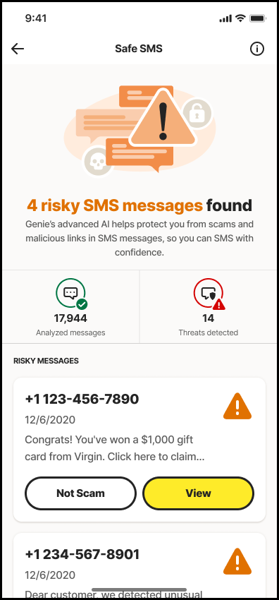
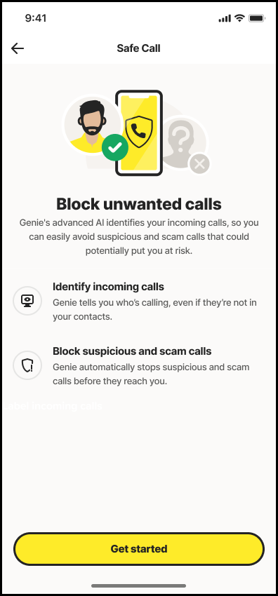
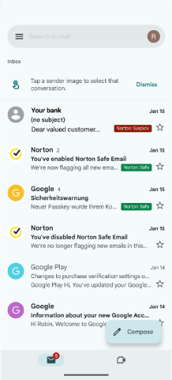
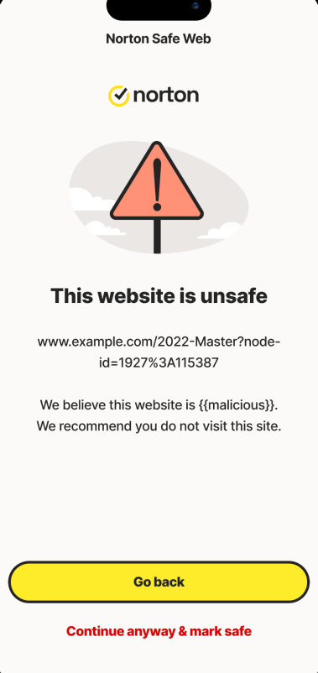
Genie Scam Protection Pro
Help Protect My Online Life
from Scams and Security Threats
Launching Summer 2025
Safe SMS
Safe Call
Safe Email
Safe Web
Detects sophisticated scams in
text messages, giving you advanced protection against scams and
peace of mind when checking
your messages.
Automatically blocks scam
calls or labels incoming calls as
scam, junk, or a business, so you’ll know if you should answer.
Proactively scans and flags
both safe and suspicious emails, detecting sophisticated scams
so you’ll know it it’s a scam
before opening.
Helps protect you from scams
when shopping or browsing online
by checking for hidden scams
in the pages you visit.

Slide 16
Help me understand my finances
Introducing: Financial Wellness
Notes:
65% of consumers in the US are living paycheck to paycheck.

Slide 17

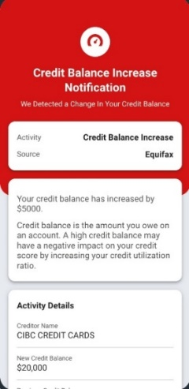
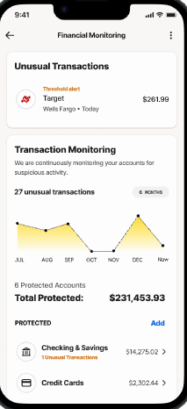
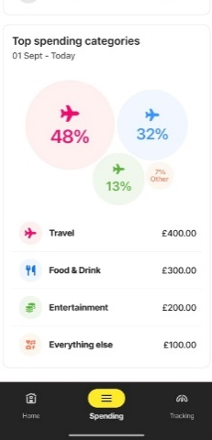
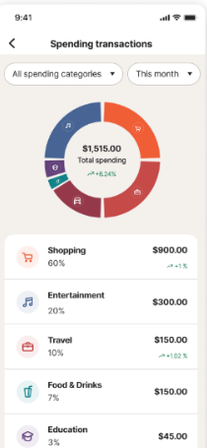
Expanding Financial Wellness
Help Me Understand My Finances
help me understand my finances
NEW
Coming Fall 2025*
Credit Score
Factors & Insights
Income Tracking
Spending Tracking
Spending Insights
Actionable credit score insights
that are dynamic and relevant to your latest credit activities.
A single dashboard with checking, saving, and investment accounts for a full view of your financial assets.
See spend by category and view trends on spending behavior. Trends are highlighted to see impact on financial goals.
Receive intelligent insights and tools to help improve your
financial health.
*Features and timeline subject to change.

Slide 18
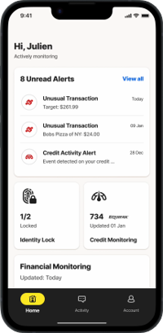
Income & Spending Tracking
Help Me Understand My Finances
Essential, Premier, Premier Plus, Executive
Launching Summer 2025
Coming Fall 2025* in all Norton LifeLock Benefit Plans
Visual overview of all your account balances across savings, credit,
and investments.
Provide an aggregated view of overall finances, showing how much was spent, earned, and actively monitored
via LifeLock.
Review recent transactions by highlighting suspicious, pending, and high-value transactions.
Manage expenses across multiple categories while offering key insights into fluctuations in spending across different categories month over month.
*Features and timeline subject to change
Screens modified for demonstration purposes.

Slide 19
Accessing Your Norton LifeLock Benefit Plan

Slide 20

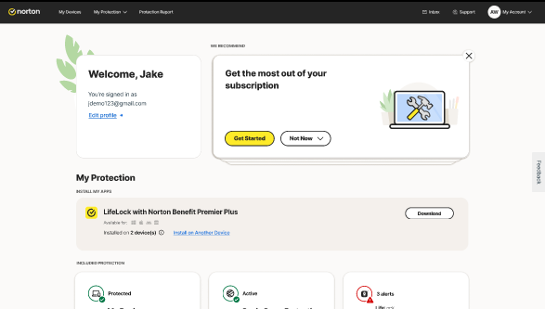
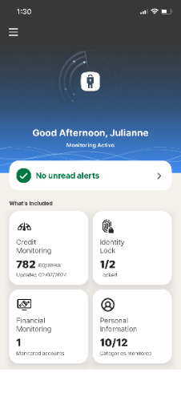
Streamlined
Member Dashboard
Initiate Demo
Integrated, intuitive, and proprietary user experience
on web & mobile
4.7 stars
122K reviews (iOS)
4.6 stars
1.88M reviews (Android)
Screens modified for demonstration purposes.
As of January 2025

Slide 21
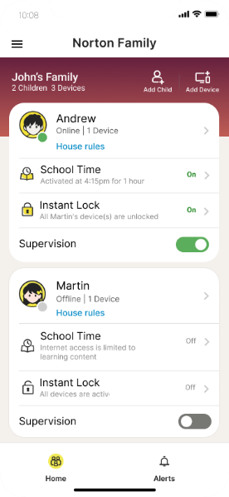
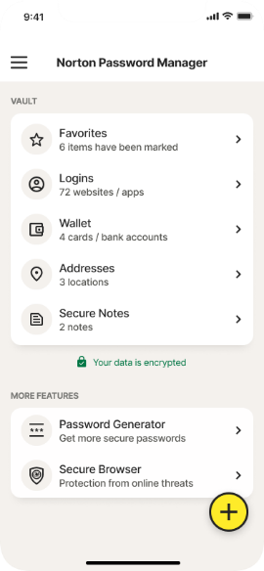
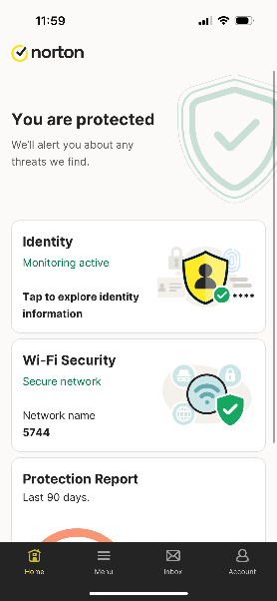
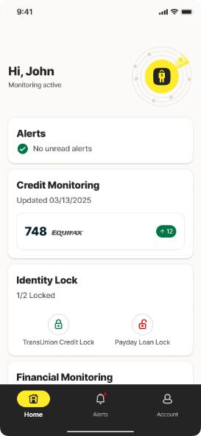
Yes, We Have An App for That
Norton Family Parental Control
Norton Password Manager
Norton 360
LifeLock Identity

Slide 22
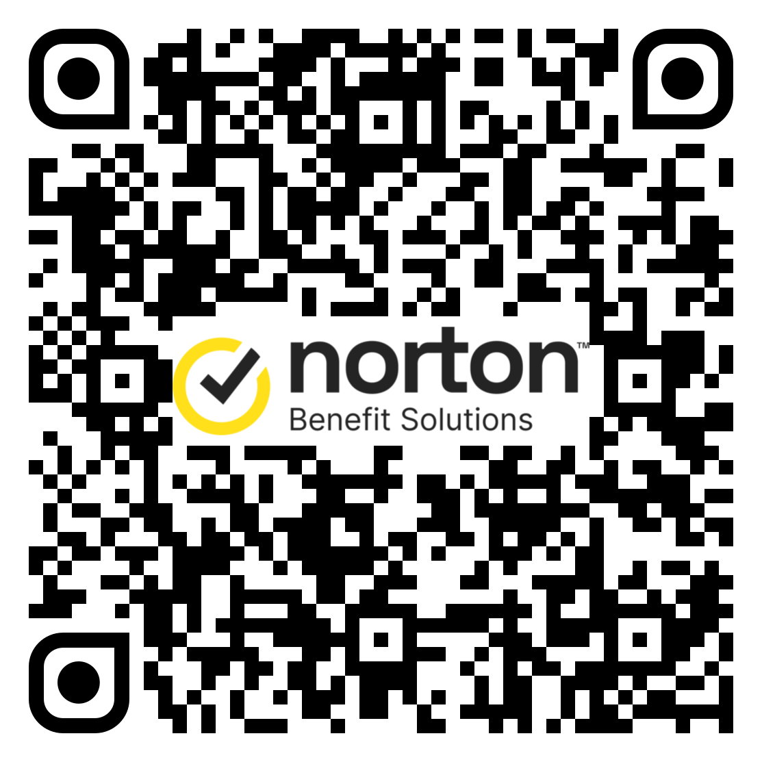
Questions?
Scan the QR Code to learn more about LifeLock with Norton Benefit Premier.
Notes:
Prem

