Slide 1





My Teradyne Benefits
2027 Annual Open Enrollment
Health | Wealth | Peace of Mind
Annual Enrollment: November 3 – November 20, 2026

Slide 2







It’s Time to Enroll for 2027 Benefits
Annual Enrollment: November 3 – November 20, 2026
Teradyne offers a variety of benefits for our diverse workforce.
Annual enrollment is your once-a-year opportunity to make new benefit elections for the coming year.
Take a fresh look at your options in light of these 2027 changes:
  2027 contribution rates for medical, dental, and vision
  Enhanced dental benefits
  The Hartford: new carrier for life, disability, leave, and supplemental health, plus a special Voluntary Life enrollment opportunity
  “Dispense As Written” prescription rules
  Higher IRS deductibles and HSA limits
Your 2026 HSA and FSA elections will not carry forward. Make an active election.
You choose the coverage you value most

Slide 3
What’s New for 2027

Slide 4

Medical, Dental, and Vision Rate Changes
WHAT’S NEW FOR 2027
Employees and Teradyne share the cost of coverage, with Teradyne paying the majority. When medical and pharmacy costs go up, both employees and the company pay more. For 2027, premiums will change by plan:
+18.2%
+4.1%
+6.6%
−0.3%
+0.1%
+6.5%
0%
Health Investment Plan with HSA
Advantage Blue (EPO)
Blue Care Elect Preferred (PPO)
Kaiser HMO (CA only)
Kaiser HMO w/HSA (CA only)
Dental
Vision
IRS-required deductible changes for the Health Investment Plan and Kaiser HSA. Minimum deductible is $1,750 for individual coverage ($50 increase from 2026) and $3,500 for individual plus one and family coverage ($100 increase from 2026).
While no one likes to see costs increase, Teradyne offers plan choice and other resources to help you maximize your benefits value.
To learn more about your 2027 benefit options, visit www.teradyne.com/benefits
Notes:
Kaiser HMO premiums decrease 0.3%; Kaiser HSA increases 0.1%. All other changes are increases. Dental +6.5%, vision unchanged.

Slide 5


2027 Open Enrollment Highlights
WHAT’S NEW FOR 2027
Changes that take effect January 1, 2027
Enhanced Dental Benefits
Life and Disability by The Hartford
Pharmacy: Dispense As Written
Calendar-year maximum increases to $2,000 per person, and the lifetime orthodontia benefit increases to $2,000.
Rollover Max: keep up to $500 of unused benefits each year (up to $1,500 total) when claims stay at $700 or less and you have a cleaning or exam.
New carrier for leave, life, disability, accident, hospital indemnity, and critical illness.
Special enrollment opportunity: This year, enroll in or increase Voluntary Life for yourself and/or your spouse up to the Guarantee Issue Limit.
Pharmacies will fill prescriptions according to your prescriber’s “Dispense As Written” (DAW) designation.

Slide 6


Important Updates to Your HSA and FSA Accounts
WHAT’S NEW FOR 2027
For 2027, you must make an active election if you want any of these pre-tax benefits
HSA limits increase
Health Care FSA
Dependent Care FSA
$4,500 individual
$9,000 family
$3,400 annual limit
$680 rollover
$7,500 annual limit
Employees 55+ not enrolled in Medicare can add a $1,000 catch-up.
Limited Purpose FSA has the same limits.
Grace period: incur 2026 expenses by March 15, 2027 and submit claims by March 31, 2027. Incur 2027 expenses by March 15, 2028.
Enrolled in the Health Investment Plan or Kaiser HSA? Your 2026 HSA employee election will not carry forward to 2027. To have HSA payroll deductions in 2027, you must make an active election.
Notes:
Health Care FSA figures ($3,400 / $680) are as published in the 2027 newsletter. Confirm the final IRS 2027 limit before presenting.

Slide 7
Resources for Maximizing Value

Slide 8



Teradyne Resources to Maximize Your Benefits Value
RESOURCES FOR MAXIMIZING VALUE
Choice of plans
Don’t overspend on coverage. Use the Teradyne Healthcare Calculator to find the plan that fits you best.
Strong network, free preventive care
Preventive care is covered at 100% across all Teradyne medical plans when you use a network provider.
Generic prescription drugs
Generics are as safe and effective as brand-name drugs. If your prescription allows it, choose the generic to save.
Supplemental medical coverage
A lower-cost, higher-deductible plan plus supplemental coverage from The Hartford may protect you better, for less.
Tax-advantaged accounts
Stretch your dollars with a Health Savings Account (HSA) or Flexible Spending Account (FSA).
Wellness resources and more
Fitness and weight loss reimbursements, Employee Assistance Program, family care support, and member advocacy.

Slide 9





Free Preventive Care
RESOURCES FOR MAXIMIZING VALUE
Covered 100% across all Teradyne medical plans when you see an in-network provider
Tests
Cancer Screenings
Counseling
Blood pressure, diabetes, cholesterol
Including mammograms and colonoscopies
Quit smoking, eat healthy, treat depression
Kids
Vaccinations
Healthy Pregnancy
Well-baby and well-child visits from birth to age 21
COVID-19, flu, pneumonia, measles, polio, meningitis
Counseling, screenings, and vaccines
Preventive care is provided at no out-of-pocket cost when you use a network provider.

Slide 10
A Strong Provider Network
RESOURCES FOR MAXIMIZING VALUE
Know where to go for the most appropriate care
 | Telemedicine | Doctor’s Office | Urgent Care | Emergency Room
Use it for | A common, non-emergency issue that can be diagnosed by phone or online | A condition that doesn’t need immediate attention and can wait until the next day | A condition that needs immediate care but is not life- or limb-threatening | A life-threatening or potentially crippling condition that needs immediate attention
Examples | Colds and allergies, flu/cough; ear infections, pink eye; behavioral health | Sore throat, fever; routine exam, screening; checkup, vaccine, prescription refill | Broken bone, severe sprain or strain; cut requiring stitches; anxiety attack | Sudden weakness, dizziness, or loss of consciousness; uncontrollable bleeding; chest pain, difficulty breathing
Cost* | Your cost: $10 (PPO/EPO) | Average price: $ $0 (preventive); $176 (non-preventive) | Average price: $$ $229 | Average price: $$$ $821 (minor); $1,644 (moderate); $3,069 (severe)
*Average prices for doctor’s office, urgent care, and ER are from healthcarebluebook.com. Contact your health insurance carrier for your specific costs.
You’ll pay less when you use a Blue Cross Blue Shield (or Kaiser) network provider and choose the most appropriate place for care.

Slide 11
Opt for Generic Prescription Drugs
PHARMACY BENEFIT
Comparing in-network costs by tier
 | Health Investment Plan with HSA | Blue Care Elect Preferred (PPO) | Advantage Blue (EPO) | Kaiser (CA only) | Kaiser HSA (CA only)
Retail 30-day supply | After deductible* Tier 1: $10 Tier 2: $30 Tier 3: $50 | Tier 1: $10 Tier 2: $30 Tier 3: $50 | Tier 1: $10 Tier 2: $30 Tier 3: $50 | Generic: $10 Brand-name: $25 | After deductible Generic: $10 Brand-name: $30
Mail-Service or Smart90 Up to 90-day supply | After deductible* Tier 1: $20 Tier 2: $75 Tier 3: $125 | Tier 1: $20 Tier 2: $75 Tier 3: $125 | Tier 1: $20 Tier 2: $75 Tier 3: $125 | Generic: $20 Brand-name: $50 100-day supply | After deductible Generic: $20 Brand-name: $60 100-day supply
* Deductible waived for certain preventive medications. Prescription coverage for the Blue Cross Blue Shield of MA plans is provided by Express Scripts.

Slide 12
New for 2027: Dispense As Written
PHARMACY BENEFIT
Effective January 1, 2027
What DAW means for you
Smart90 Pharmacy Network
Fill 90-day maintenance prescriptions at Walgreens or CVS Smart90 pharmacies, or by mail through Express Scripts. You pay less per 90-day supply than for three 30-day fills, and visit the pharmacy only every three months.
Pharmacies will fill prescriptions according to the “Dispense As Written” designation.
If your prescription allows a generic substitution, the pharmacy may fill the generic.
If your prescriber specifies the brand-name medication, the pharmacy will dispense the brand as written.
Talk with your doctor about whether a generic is right for you.
Express Scripts
Find pharmacies, compare drug costs, view the preventive drug list, and order refills at www.express-scripts.com/teradyne, in the mobile app, or by texting JOIN to 69717. Member Services: 1-866-814-7118.

Slide 13
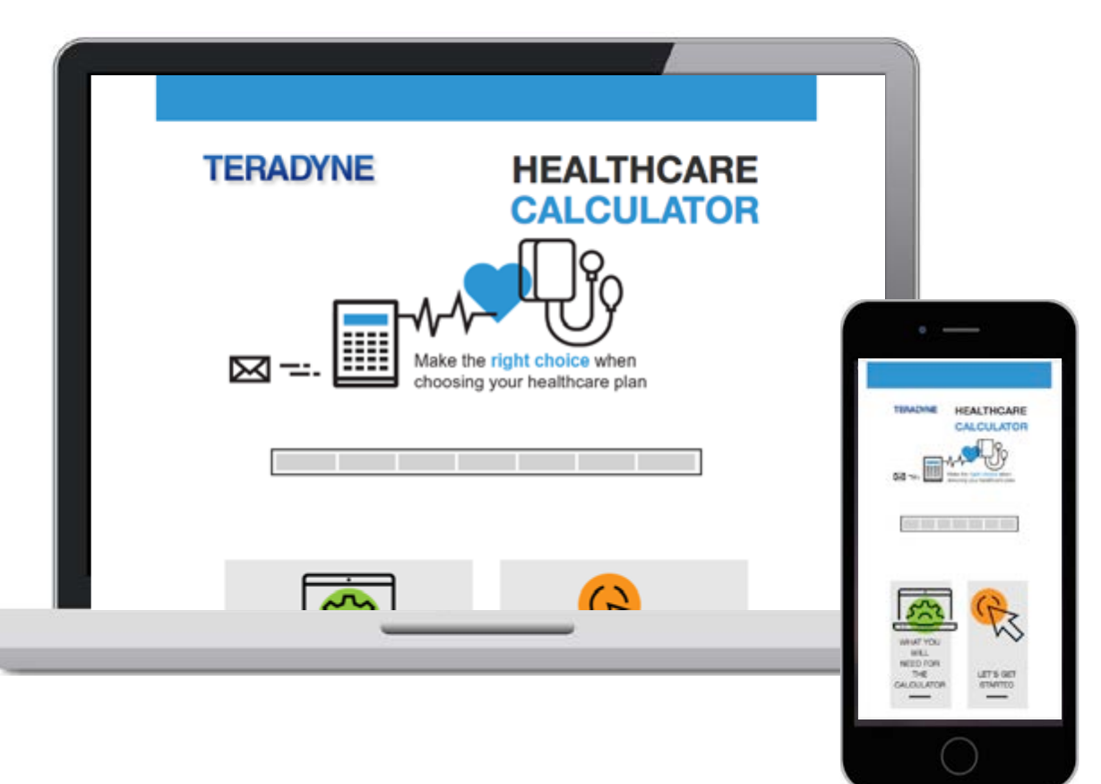



Choice of Plans
RESOURCES FOR MAXIMIZING VALUE
Teradyne Healthcare Calculator: Powered by Fidelity
Try it for yourself!
Select your coverage level
Estimate your expected medical expenses and model scenarios
Get a plan recommendation based on your data
See the projected value of an HSA over time
Visit www.teradyne.com/benefits

Slide 14
The Hartford Voluntary Benefits
SUPPLEMENTAL HEALTH
New carrier for 2027: cash benefits paid directly to you, on top of your medical plan
Critical Illness
Accident
Hospital Indemnity
Pays cash benefits when you’re diagnosed with a serious condition, such as a heart attack, end-stage renal failure, or cancer.
Pays cash benefits if you or a covered dependent is injured in a covered accident off the job, no matter what your medical plan covers.
Pays benefits when you have a hospital stay due to an illness, injury, surgery, or delivering a baby.
Plan details and rates: www.teradyne.com/benefits and www.teradynevoluntarybenefits.com

Slide 15
Medical + Supplemental Medical Coverage
RESOURCES FOR MAXIMIZING VALUE
An example of the power of combined coverage
Consider Emma: family history of cancer, individual coverage. Emma is 32 and healthy, with clear screenings. She wants to be financially ready if she needs treatment, with in-network expenses likely to exceed the out-of-pocket maximum.
Which is better value if she is diagnosed: the PPO, or the Health Investment Plan HSA plus Critical Illness coverage?
 | PPO | Health Investment Plan | Critical Illness Insurance
Annual cost of coverage* | $4,023 | $2,670 | $73**
In-network out-of-pocket maximum | $3,000 | $4,300
Less Teradyne’s HSA contribution | N/A | – $800
Critical Illness benefit |  |  | $15,000 paid to Emma
Emma’s net costs | $7,023 | $6,170 | $73
HIP + Critical Illness
$6,243
vs. $7,023 for the PPO alone. And if Emma is diagnosed, the $15,000 Critical Illness benefit could cover 100% of her out-of-pocket costs.
*2027 employee cost (26 bi-weekly paychecks). **Rate shown for a 32-year-old non-smoker.
Notes:
Updated with 2027 bi-weekly rates (PPO $154.73, HIP $102.70 individual) and the 2027 HIP out-of-pocket max ($4,300). Confirm the PPO out-of-pocket max ($3,000) and The Hartford Critical Illness rate ($73) before presenting.

Slide 16
Tax-advantaged Accounts
RESOURCES FOR MAXIMIZING VALUE
Pay eligible expenses tax-free with an HSA or FSA
Account | Who is eligible? | Who contributes? | Carryover
Health Savings Account (HSA) | Health Investment Plan with HSA; Kaiser HSA (CA only) | Teradyne: $800 individual / $1,600 dependent coverage (deposited by Jan. 15, 2027) Employees: balance to IRS max of $4,500 / $9,000 (+$1,000 if 55+) | Unlimited rollover
Health Care FSA | PPO, EPO, Kaiser HMO (CA only), and employees who waive coverage | Employees only, up to $3,400 for 2027 | Rollover up to $680
Limited Purpose Health Care FSA (dental and vision only) | Health Investment Plan with HSA; Kaiser HSA (CA only) | Employees only, up to $3,400 for 2027 | Rollover up to $680
Dependent Care FSA (child and elder care) | All employees | Employees only, up to $7,500 for 2027 | Grace period: incur 2027 expenses through March 15, 2028

Slide 17
2027 HSA Plan Details
HEALTH INVESTMENT PLAN
Your Fidelity HSA is a portable, tax-exempt account that’s yours to keep
Health Investment Plan with HSA | Individual | Indiv. + One | Family
Calendar Year Deductible | $1,750 | $3,500 | $3,500
Out-of-Pocket Maximum** | $4,300 | $8,550 | $8,550
Employer Contribution | $800 | $1,600 | $1,600
Employee Contribution | Up to $3,700 | Up to $7,400 | Up to $7,400
Total combined contribution limit* | $4,500 | $9,000 | $9,000
Kaiser HSA (CA only) | Individual | Indiv. + One | Family
Calendar Year Deductible*** | $1,750 | $3,500 | $3,500
Out-of-Pocket Maximum | $3,400 | $6,800 | $6,800
Employer Contribution | $800 | $1,600 | $1,600
Employee Contribution | Up to $3,700 | Up to $7,400 | Up to $7,400
Total combined contribution limit* | $4,500 | $9,000 | $9,000
*Up from $4,400 / $8,750 in 2026. Catch-up for members 55+: $1,000 (until age 65). **Embedded out-of-pocket max of $4,300 per family member for Individual Plus One and Family tiers. ***Each member’s deductible in a family of two or more cannot exceed $3,500.
Teradyne front-loads its 2027 HSA contribution by January 15, 2027. Fidelity estimates a 65-year-old retiring this year needs about $185,000 for medical expenses in retirement. An HSA helps you save for it.

Slide 18

Fitness and Weight Loss Reimbursements
WELLNESS RESOURCES AND MORE
For those enrolled in a Blue Cross Blue Shield medical plan
Qualified Fitness Program
Qualified Weight Loss Program
Receive up to $150 annually for:
Full-service health club with cardio and strength equipment
Fitness studio classes (yoga, Pilates, Zumba®, spinning, and more)
Home cardio and strength-training equipment
Online fitness memberships and classes
Receive up to $150 annually for:
Weight Watchers® in person or online
Hospital-based programs
Non-hospital programs combining healthy eating, exercise, and coaching with certified health professionals
Excludes personal trainers, initiation/termination fees, gymnastics, tennis, pool-only facilities, martial arts, dance, country/social clubs, sports teams.
Excludes initiation/termination fees, food, supplements, books, scales, exercise equipment, and individual nutrition counseling.
Reimbursement forms: bluecrossma.com/myblue. Acupuncture is also covered in-network (PPO/EPO $40 copay; HIP 20% after deductible; up to 12 visits).

Slide 19

TELUS Health Employee Assistance Program
WELLNESS RESOURCES AND MORE
A confidential, professional support service for you and your dependents, available 24/7
The EAP can help you:
Strengthen relationships and communication
Deal with stress, anxiety, and depression
Resolve personal and emotional difficulties
Address marital and relationship difficulties
Understand grief and bereavement
Find solutions for work-related issues
Work toward life goals
Cope with isolation and loneliness
Adapt across cultures and culture shock
Address alcohol and drug misuse
Access crisis and trauma support
Free for you and your dependents. No medical plan enrollment required.
Up to three counseling sessions at no cost.
one.telushealth.com
Username: TeradyneUS
Password: EAP
1-888-851-7032
Notes:
Phone number updated to 1-888-851-7032 per the 2027 newsletter (the 2026 deck listed 1-800-635-0606). Confirm which is current.

Slide 20





Bright Horizons Enhanced Family Marketplace
WELLNESS RESOURCES AND MORE
Balancing work and parenting is a challenge. Our partnership with Bright Horizons helps make it easier.
Preferred enrollment at Bright Horizons Centers. Priority over community families on the waitlist and waived registration fees.
Partner Center discounts. Discounts at over 2,500 Partner Centers; most common discount is 10%.
Free Sittercity premium membership. Find babysitters, pet sitters, and more, with basic background checks.
Tutoring discounts. Sylvan Learning, Revolution Prep, Varsity Tutors, and MarcoPolo Learning.
Years Ahead elder care. Free membership with elder care resources and a caregiver directory.
Available at no cost to you. Learn more at my.brighthorizons.com/Teradyne

Slide 21



Member Advocacy Support through Carenet
WELLNESS RESOURCES AND MORE
MyAdvocate, your Personal Health Assistant: an extension of our HR team
Assistance with claims or billing issues
Eligibility determination and coordination of benefits
Finding the highest-quality in-network doctors
Comparing treatment costs in your area
Explaining benefits in easy-to-understand language
Education on Medicare and Exchange enrollment
Available 24/7. A Care Coordinator gathers information and refers you to an Advocate who stays with you until your issue is resolved. Covers you, family members in your home, and your parents and parents-in-law.
Carenet is available at no cost to you. MyAdvocateServices.com

Slide 22
Get Ready to Enroll

Slide 23

Your Benefit Options At-a-Glance
GET READY TO ENROLL
Annual Enrollment: November 3 – November 20, 2026
Medical
Dental & Vision
Disability (The Hartford)
Advantage Blue (EPO)
Blue Care Elect Preferred (PPO)
Health Investment Plan
Kaiser and Kaiser HSA (CA only)
Rx through Express Scripts (BCBS plans)
Delta PPO Plus Premier, now with a $2,000 annual max
Vision Service Plan (VSP)
Basic STD: fully paid by Teradyne
Supplemental STD: optional
LTD: fully paid by Teradyne
Life Insurance (The Hartford)
Other Benefits
Basic: fully paid by Teradyne
Supplemental: enroll or increase up to guaranteed issue this year
Accident, Critical Illness, Hospital Indemnity (The Hartford)
HSA, Health Care FSA, Limited Purpose FSA, Dependent Care FSA
MetLife Legal Plan; NortonLifeLock ID Theft

Slide 24
What Happens If You Don’t Enroll?
GET READY TO ENROLL
Update your elections between November 3 – November 20, 2026
If you don’t take action, your current 2026 benefits carry over into 2027 except your elections for these accounts:
Health Savings Account (HSA)
Health Care FSA
Limited Purpose Health Care FSA
Dependent Care FSA
You must make an election each year if you want any of these pre-tax benefits.
Reminder: the Health Care FSA has a $680 annual rollover limit. Dependent Care FSA participants have until March 15, 2027 to incur eligible 2026 expenses and until March 31, 2027 to submit claims.

Slide 25


How to Enroll
GET READY TO ENROLL
Make your elections in Benefitfocus by November 20, 2026
The decisions you make during Open Enrollment affect your whole family, so share this information with the other decision makers in your household. Review plan details at www.teradyne.com/benefits, then enroll in Benefitfocus. For family coverage, select each dependent to be covered.
From your desktop
From your mobile device
Benefitfocus is accessible through Single Sign-On via the Benefitfocus tile or under the My Info section on your Thrive homepage.
Download the Benefitfocus mobile app from the Google Play or Apple App Store.
Changing coverage during the year
Outside Open Enrollment, changes are allowed only for an IRS qualifying life event (such as marriage, divorce, birth, adoption, or a change in employment status), and must be consistent with the event. Changes are allowed within 30 days of the life event happening.

Slide 26

Other Considerations
GET READY TO ENROLL
Whether or not you make changes, now is a great time to get ready for the new year
Update your beneficiaries for life insurance in Benefitfocus
Update your covered dependents and make sure their SSNs are provided and correct in Benefitfocus (required by the IRS)
Consider Voluntary Life Insurance while you can enroll or increase up to the guaranteed issue limit
Review your 401(k) elections via Fidelity
Enroll in voluntary benefits such as Auto/Home coverage, Legal Insurance, or Pet Insurance
Make sure an Emergency Contact is listed in Thrive

Slide 27
Need Help Figuring It All Out?
GET READY TO ENROLL
We have resources to make it easier
Resource | Where to go
Teradyne Open Enrollment Website | www.teradyne.com/benefits
Plan Comparisons and Summary Plan Descriptions | www.teradyne.com/benefits
Teradyne Healthcare Calculator (Fidelity) | www.teradyne.com/benefits
The Hartford Supplemental Health | www.teradyne.com/benefits
Voluntary Benefits Website (Mercer) | www.teradynevoluntarybenefits.com
Health Savings Account Resources | www.401k.com (“Health Savings Account” tile)
Carenet Member Advocacy | MyAdvocateServices.com
Questions?
HR Service Center
hr.service.center@teradyne.com
978-370-3041

Slide 28
Questions?
THANK YOU
HR Service Center | hr.service.center@teradyne.com | 978-370-3041

